Slide 1
Digital Fundamentals
CHAPTER 6 Functions of Combinational Logic

Slide 2
Chapter Outline
6–1 Half and Full Adders
6–2 Parallel Binary Adders
6–3 Ripple Carry and Look-Ahead Carry Adders
6–4 Comparators
6–5 Decoders
6–6 Encoders
6–7 Code Converters
6–8 Multiplexers (Data Selectors)
6–9 Demultiplexers
6–10 Parity Generators/Checkers
6–11Troubleshooting Applied Logic

Slide 3
Basic Adders
Half-Adder - The half-adder accepts two binary digits on its inputs and produces two binary digits on its outputs.
Sum bit and Carry bit are outputs.
Full-Adder - Full-adder accepts two input bits and an input carry bit and generates a sum output and an output carry bit.

Slide 4
Half-Adder
Simple Binary Addition
0 + 0 = 0
0 + 1 = 1
1 + 0 = 1
1 + 1 = 10
Zero plus zero equals zero
Zero plus one equals one
One plus zero equals one
One plus one equals zero with a carry of one

Slide 5
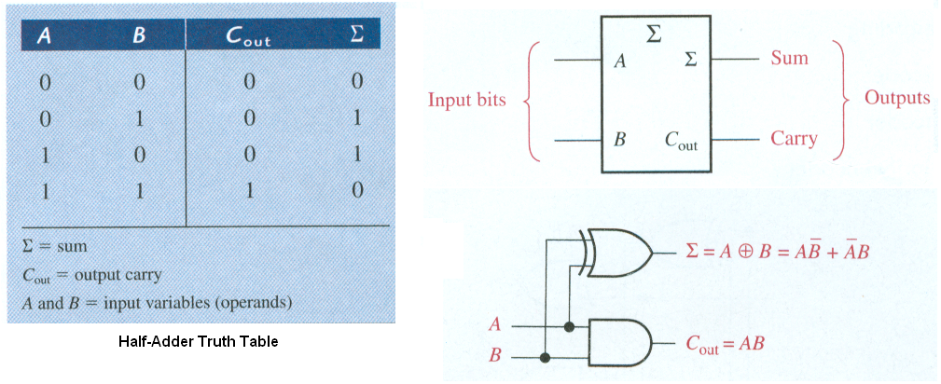
Half-Adder

Slide 6
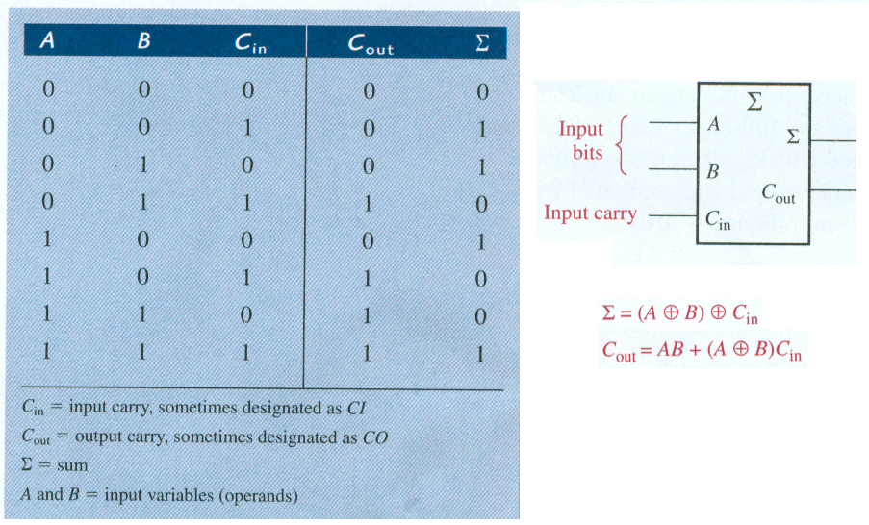
Full-Adder – Extra Input

Slide 7
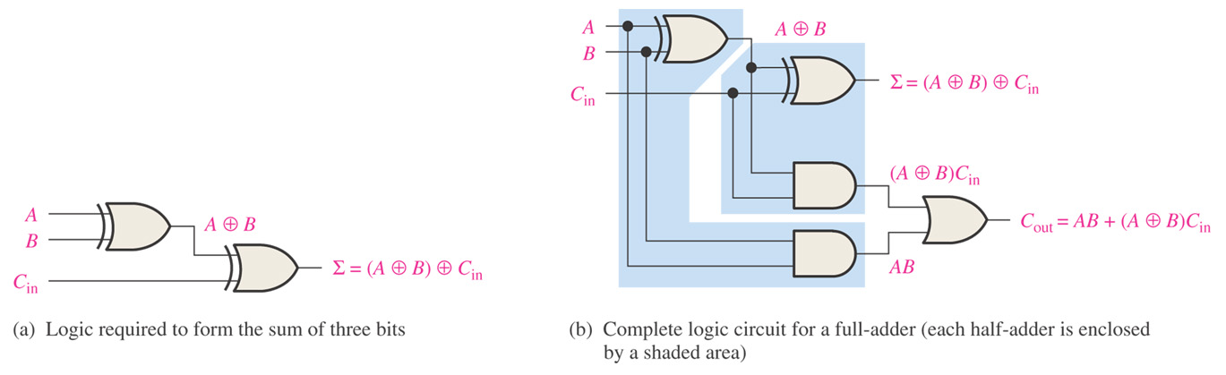
Figure 6–4 Full-adder logic.

Slide 8
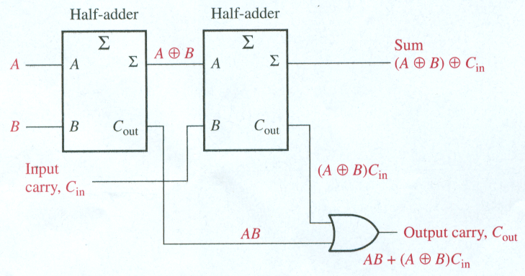
Full-Adder
Full adder from two half-adder circuits

Slide 9
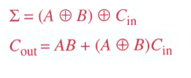
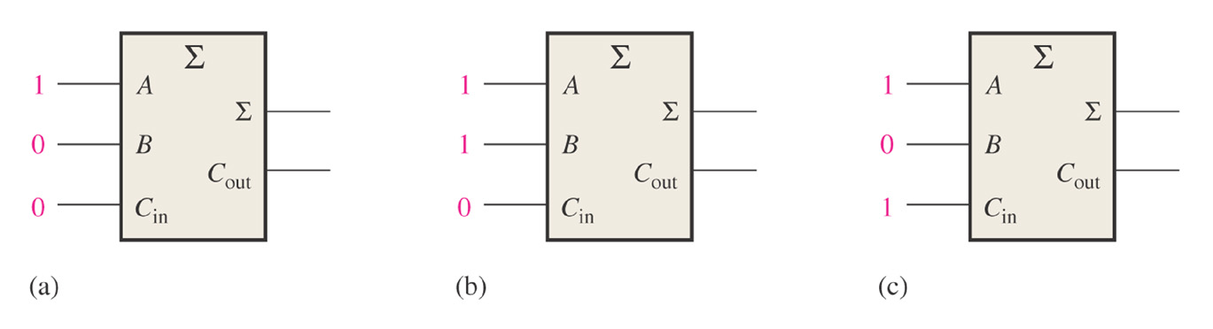
Figure 6–6. Determine the outputs for the inputs shown.
Inputs are A = 1, B = 0, and Cin = 0.
Inputs are A = 1, B = 0, and Cin = 1.
Outputs are Σ = 0 and Cout = 1.
Outputs are
Σ = 1 and Cout = 0.
Inputs are A = 1, B = 1, and Cin = 0.
Outputs are Σ = 0 and Cout = 1.

Slide 10
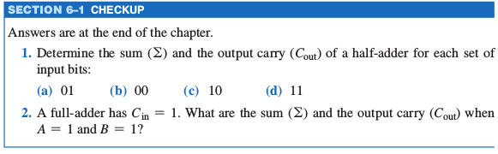

Slide 11
Parallel Binary Adders
Two or more full-adders are connected to form parallel binary adders.
To add binary numbers with more than one bit, you must use additional full-adders.
Carry bit from right column
1
1 1
+ 0 1 1 0 0
Carry bit from second column becomes a sum bit.

Slide 12
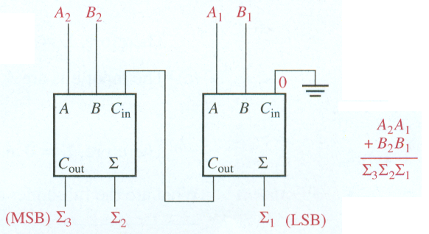
Parallel Binary Adders
Two-bit parallel binary adder using two full-adders.

Slide 13
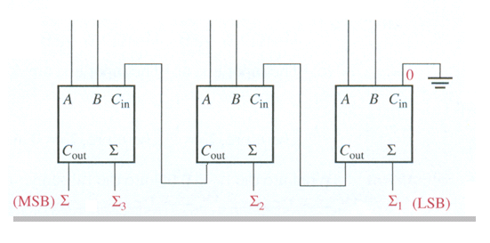
Parallel Binary Adders
Find the sum generated by the 3-bit parallel adder. Show the intermediate carries when the binary numbers 101 (A) and 011 (B) are added.
1
0
0
1
1
1
1
1
4
1
0
0
0

Slide 14
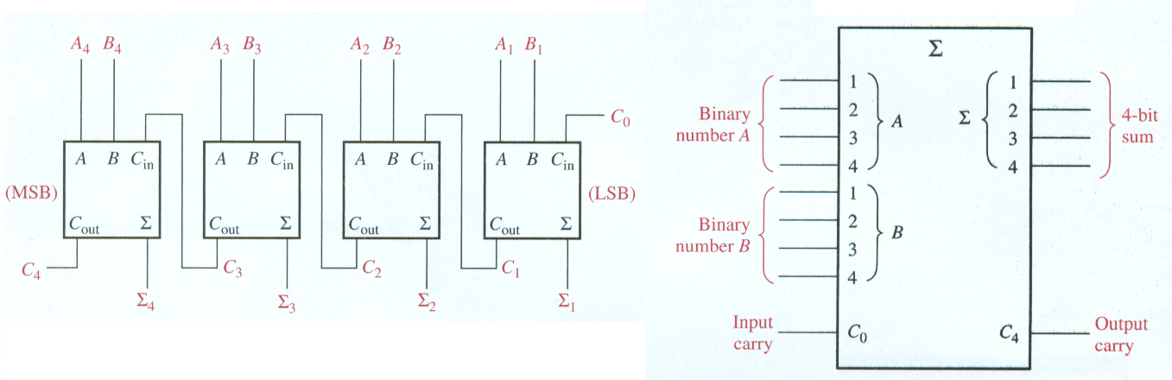
Parallel Binary Adders
Four-bit parallel binary adder
Group of four bits is called a nibble. Two nibbles is one byte.

Slide 15
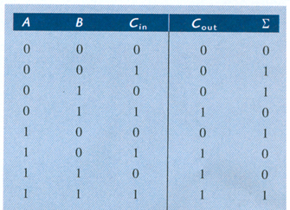
EXAMPLE 6–3
Use 4-bit parallel adder truth table to find the sum and output carry for the addition of the following two 4-bit numbers. The input carry (C_{n-1}) is 0.
A₄A₃A₂A₁ = 1100 and B₄B₃B₂B₁ = 1100
For n = 1: A₁ = 0, B₁ = 0, and C_{n-1} = 0.
From 1st row of table: Σ₁ = 0 and C₁ = 0.
C_{n-1}
C_{n}
For n = 2: A₂ = 0, B₂ = 0, and C_{n-1} = 0.
From 1st row of table: Σ₂ = 0 and C₂ = 0.
For n = 3: A₃ = 1, B₃ = 1, and C_{n-1} = 0.
From 4th row of table: Σ₃ = 0 and C₃ = 1.
For n = 4: A₄ = 1, B₄ = 1, and C_{n-1} = 1.
From last row of table: Σ₄ = 1 and C₄ = 1.
Result is 11000.

Slide 16
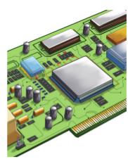
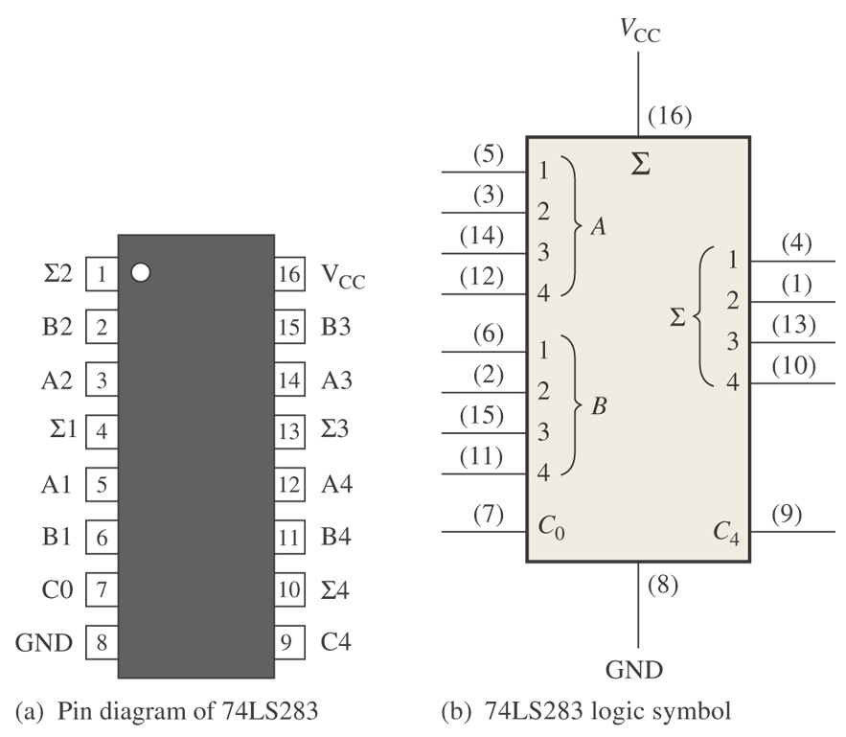
Figure 6–10 Four-bit parallel adder.
Implementation: 4-Bit Parallel Adder

Slide 17
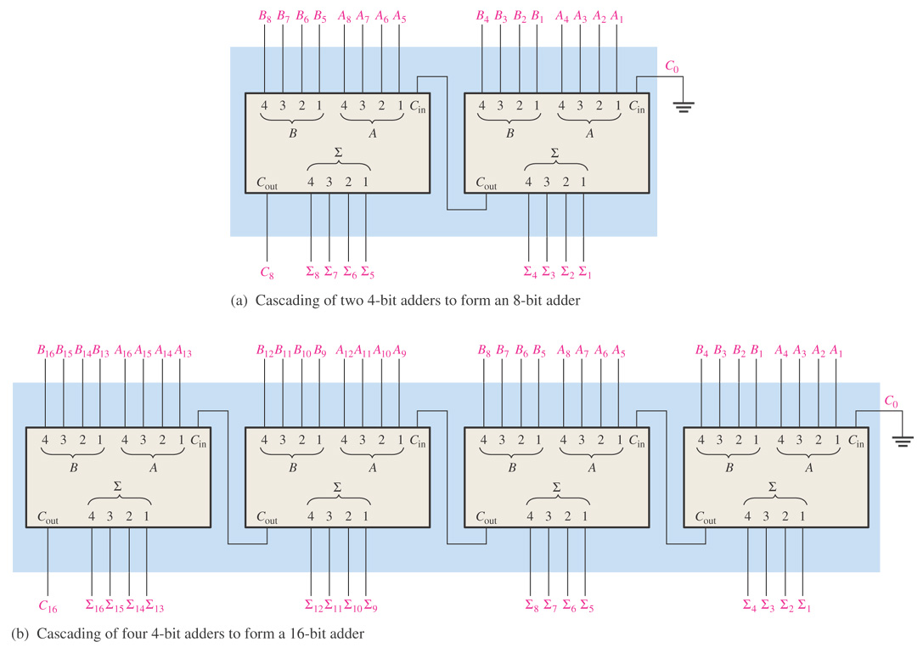
Figure 6–12 Examples of adder expansion.
Adders can be expanded to handle more bits by cascading.

Slide 18
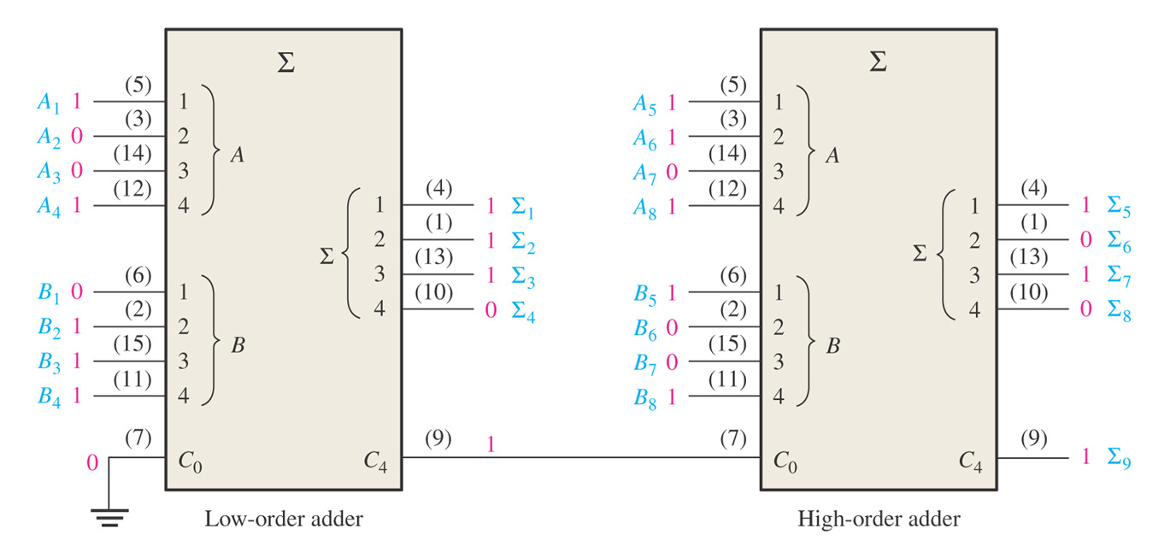
Figure 6–13 Two 74LS283 adders connected as an 8-bit parallel adder (pin numbers are in parentheses).
The following two 8-bit numbers are added. A₈A₇A₆A₅A₄A₃A₂A₁ = 10111001 and B₈B₇B₆B₅B₄B₃B₂B₁ = 10011110

Slide 19
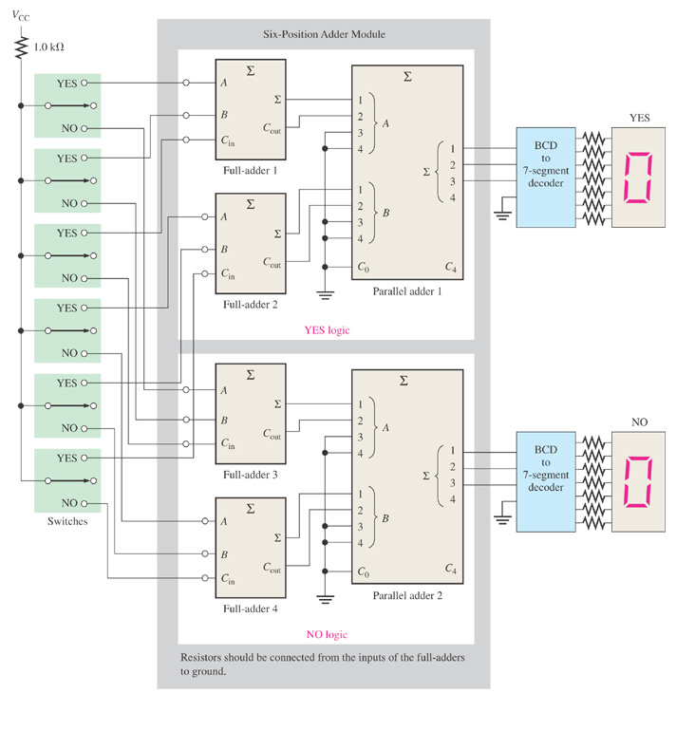
Figure 6–14 A voting system using full-adders and parallel binary adders.

Slide 20
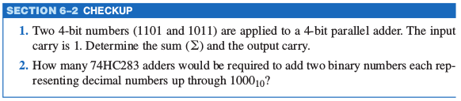

Slide 21
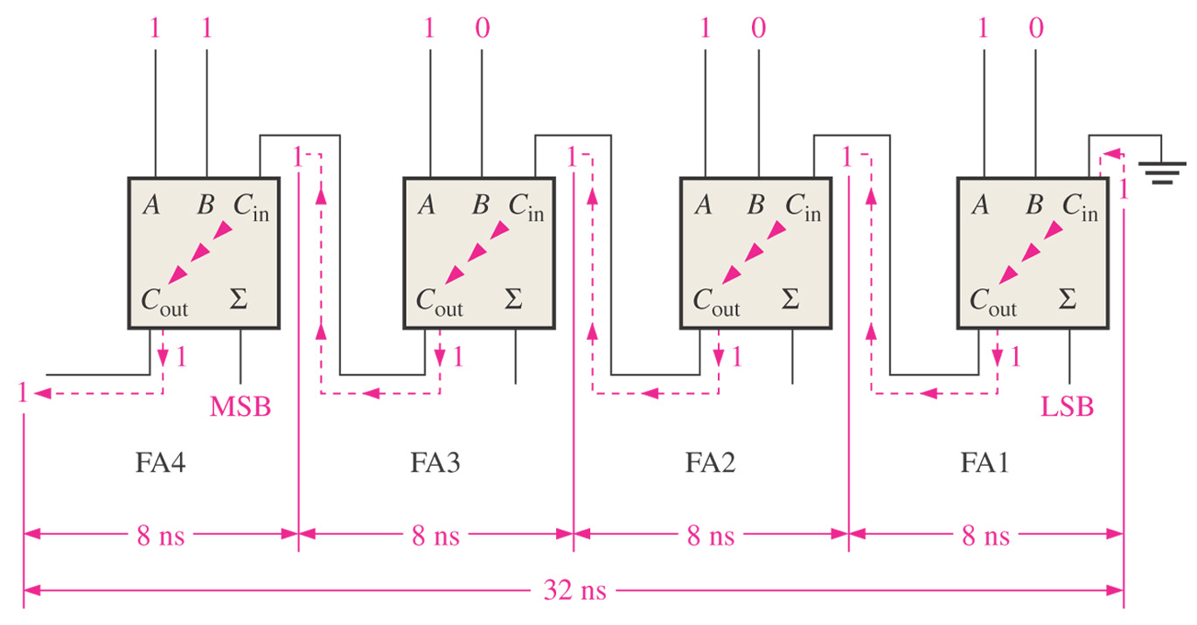
Figure 6–15 A 4-bit parallel ripple carry adder showing “worst-case” carry propagation delays.

Slide 22
Ripple Carry Adder suffers from propagation delay
Look-Ahead Carry Adder
Tries to anticipate the output carry of each stage
Carry Generation occurs when both inputs are 1
C_{g} = AB
Carry Propagation occurs when input is rippled to the output carry
C_{p} = A + B
Output Carry is a 1 if C_{g} = 1 or (C_{p} = 1 AND C_{in} = 1)
C_{out} = C_{g} + C_{p}C_{in}

Slide 23
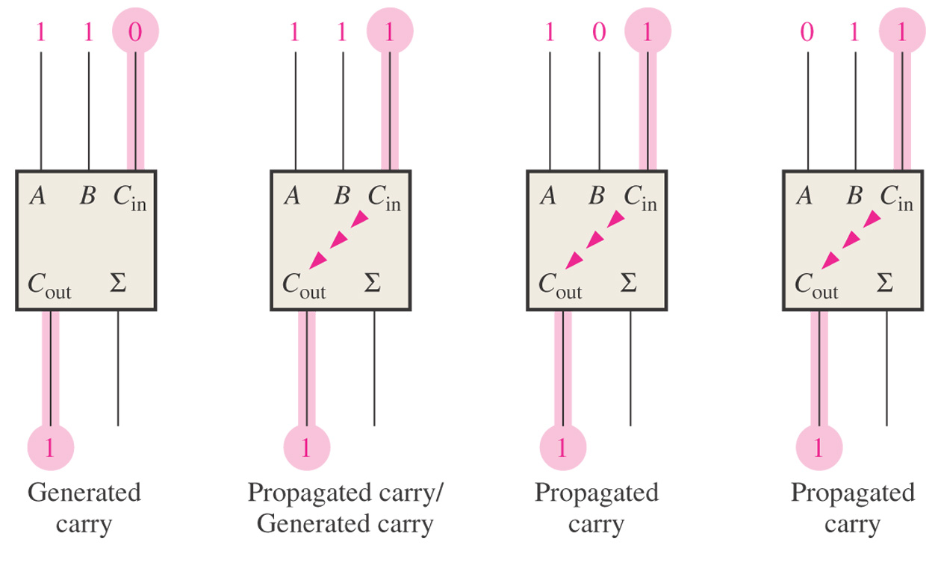
Figure 6–16 Illustration of conditions for carry generation, C_{g}, and carry propagation, C_{p}.
C_{g} = A B = 1
(A + B ) C_{in} = 1
(A + B ) C_{in} = 1
(A + B ) C_{in} = 1
C_{g} = A B = 1
Look-Ahead Carry Adder eliminates ripple carry delay. C_{out} = C_{g} + C_{p}C_{in}

Slide 24
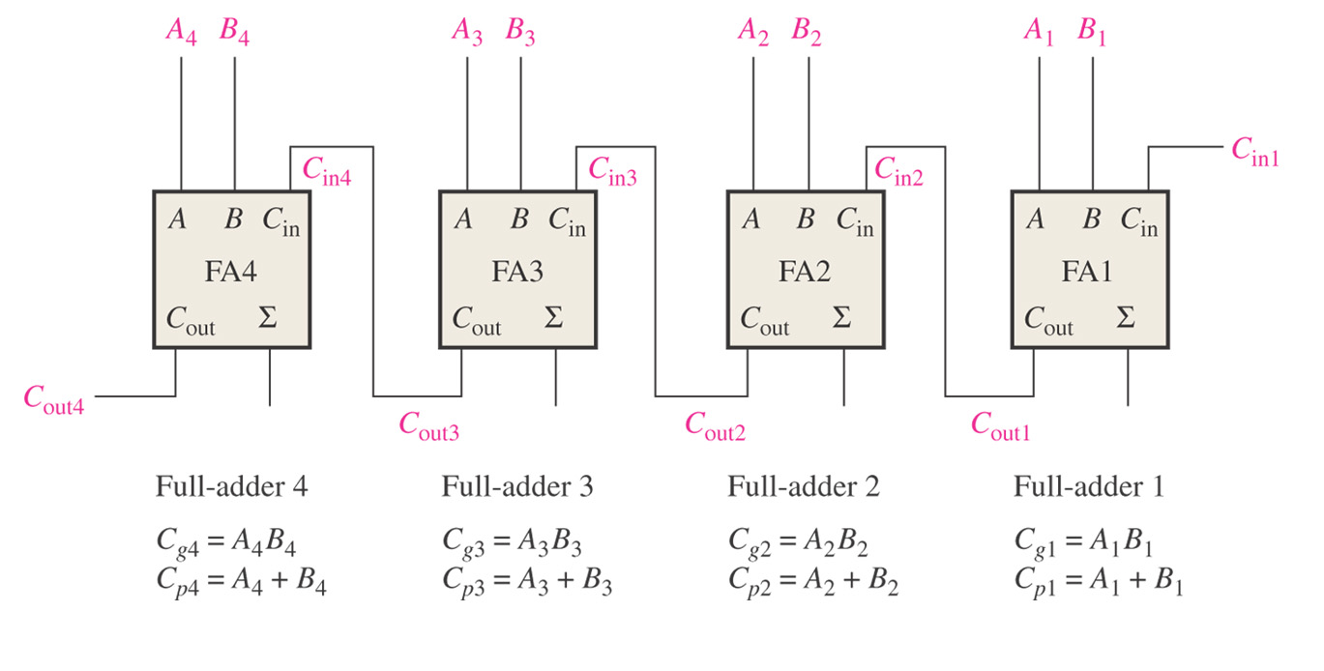
Figure 6–17 Carry generation and carry propagation in terms of the input bits to a 4-bit adder.
Thomas L. Floyd Digital Fundamentals, 9e
Copyright ©2006 by Pearson Education, Inc. Upper Saddle River, New Jersey 07458 All rights reserved.

Slide 25
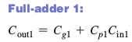
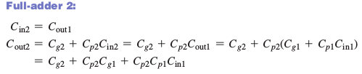
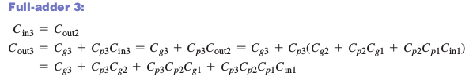
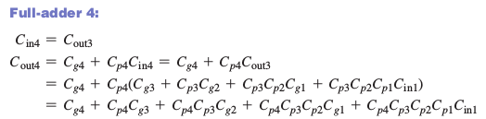
Figure 6–17 Carry generation and carry propagation in terms of the input bits to a 4-bit adder.
Thomas L. Floyd Digital Fundamentals, 9e
Copyright ©2006 by Pearson Education, Inc. Upper Saddle River, New Jersey 07458 All rights reserved.

Slide 26
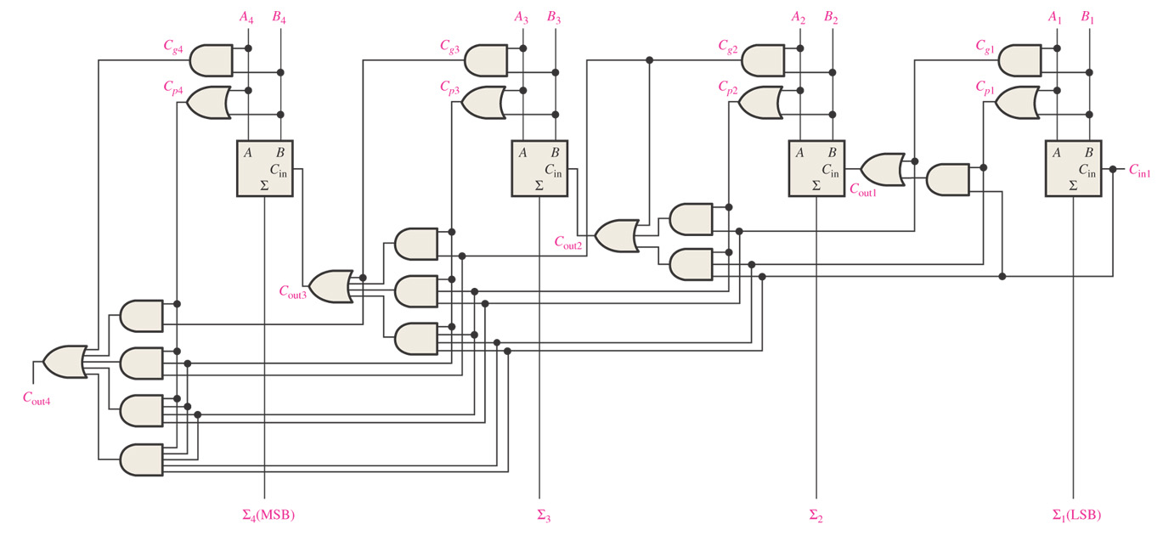
Figure 6–18 Logic diagram for a 4-stage look-ahead carry adder.
Notice that C_{in} is only dependent on inputs, so doesn’t suffer from propagation delay like the ripple adder.
Thomas L. Floyd Digital Fundamentals, 9e
Copyright ©2006 by Pearson Education, Inc. Upper Saddle River, New Jersey 07458 All rights reserved.

Slide 27
Comparators
The basic function of a comparator is to compare the magnitudes of two binary quantities
In its simplest form, a comparator circuit determines whether two numbers are equal.

Slide 28
Comparators
1-Bit Comparator
2-Bit Comparator
4-Bit Comparator

Slide 29
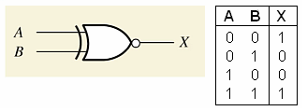
Comparators
1-Bit Comparator - Exclusive NOR
The output is 1 when the inputs are equal

Slide 30
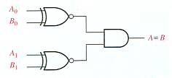
Comparators
2-Bit Comparator
The output is 1 when A₀ = B₀ AND A₁ = B₁

Slide 31
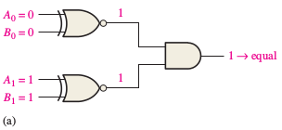
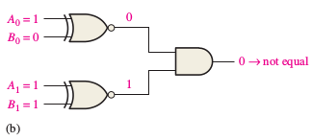
Example 6-5: Comparators
Apply each of the following sets of binary numbers to the comparator inputs in Figure 6–20, and determine the output by following the logic levels through the circuit.
(a) 10 and 10 (b) 11 and 10

Slide 32
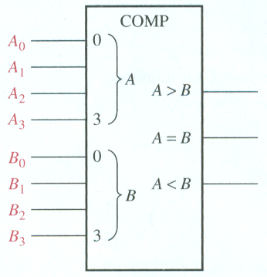
Inequality: Comparators
4-Bit Comparator
One of three outputs will be HIGH:
A greater than B (A > B)
A equal to B (A = B)
A less than B (A < B)
To determine an inequality of binary numbers A and B, you first examine the highest-
order bit in each number. The following conditions are possible:
1. If A3 = 1 and B 3 = 0, number A is greater than number B.
2. If A3 = 0 and B 3 = 1, number A is less than number B.
3. If A3 = B 3 , then you must examine the next lower bit position for an inequality.

Slide 33
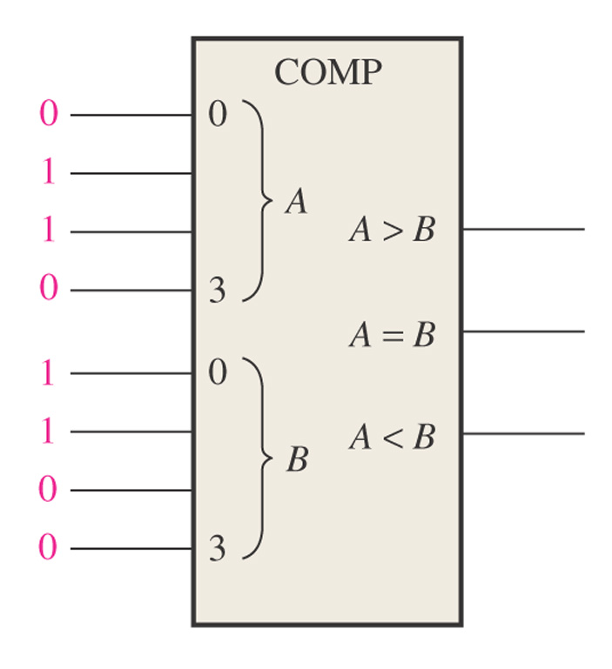
Figure 6–23 What are the outputs for the given inputs?
1
0
0
A B 0110 > 0011 YES 0110 = 0011 NO 0110 < 0011 NO

Slide 34
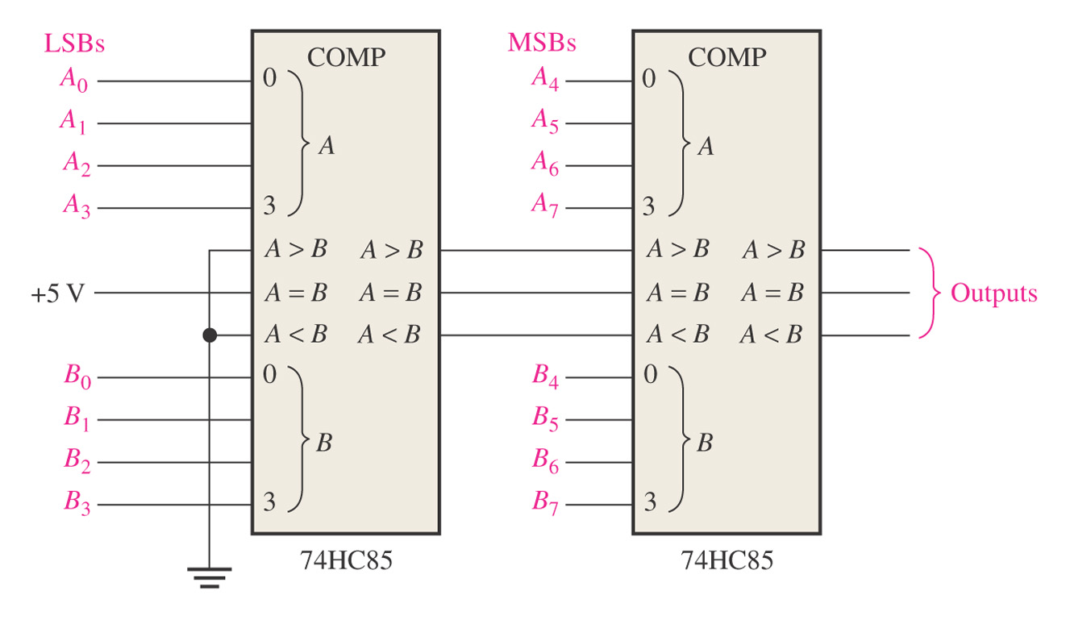
Figure 6–25 An 8-bit magnitude comparator using two 74HC85s.
Lowest-order comparator must have a LOW on A > B and A < B input and a HIGH on A = B input.

Slide 35
Decoders
Binary decoder
4-bit decoder
BCD-to-decimal decoder
BCD-to-7-segement decoder

Slide 36
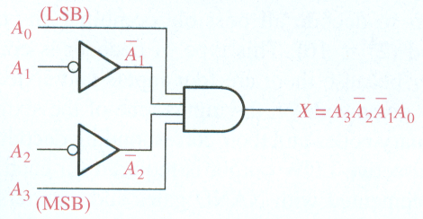
Decoders
Suppose we want to know when a binary 1001 occurs on the inputs of a digital circuit.
We can use a Decoder for this function.
Binary decoder
The output is 1 only when:
A₀ = 1
A₂ = 0
A₃ = 0
A₄ = 1
This is only one of an infinite number of examples

Slide 37
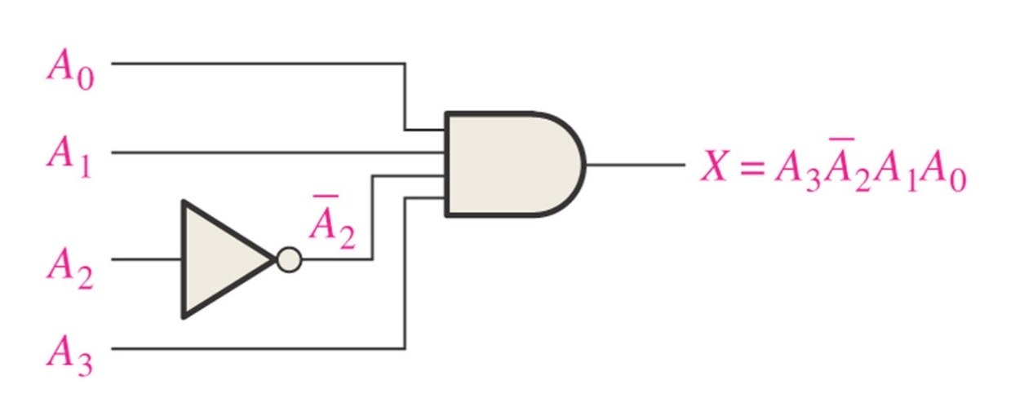
Determine the logic required to decode the binary number 1011 by producing a HIGH level on the output. LSB = A₀ (right most)
A₀ = 1, A₁ = 1, A₂ = 0, A₃ = 1
X = A₃A₂A₁A₀

Slide 38
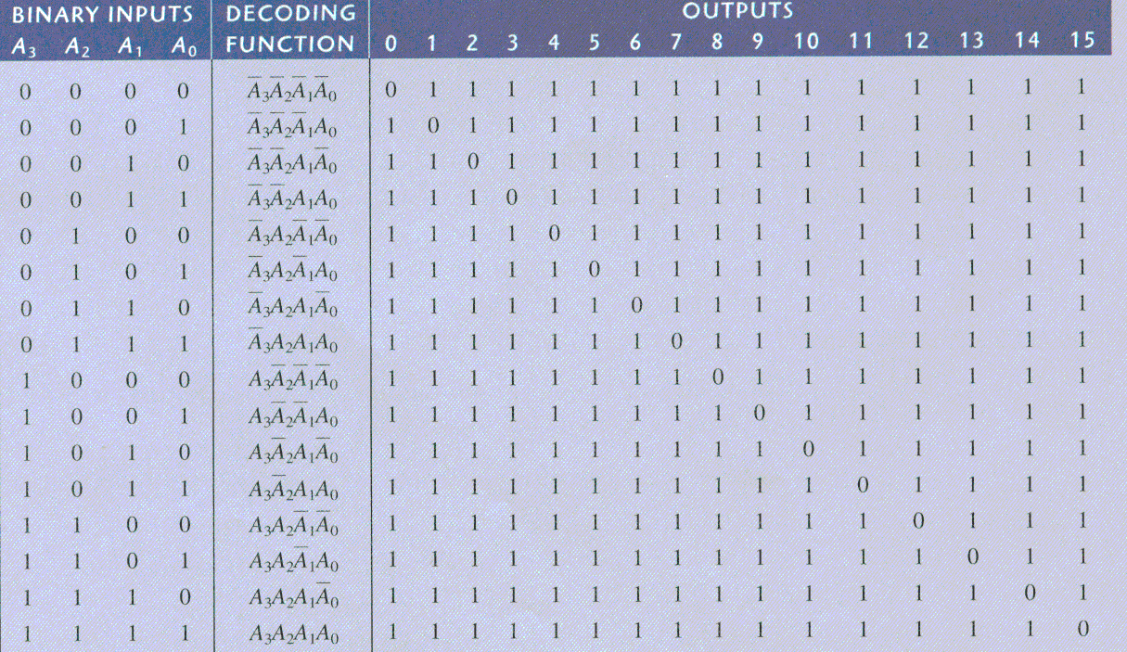
Decoders
4-bit decoder (4 line to 16 line decoder or 1 of 16 decoder)
Logic Diagram

Slide 39
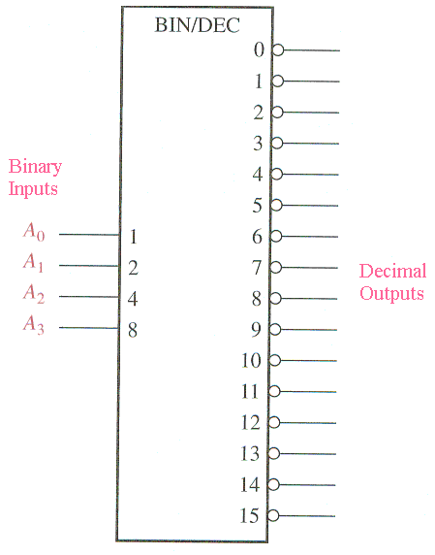
Decoders
4-bit decoder
Binary inputs
Active-low outputs (bubbles)
Truth Table
A₃A₂A₁A₀ Output 0 1 1 0 6 is low, all other outputs are high

Slide 40
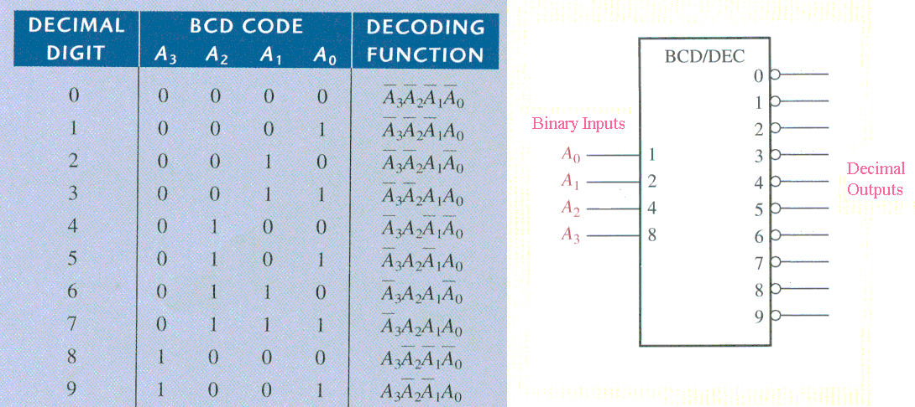
Decoders
BCD-to-decimal decoder
If 0011 is input, then output 3 is low and all other outputs are high Active Low output since bubbles on outputs.

Slide 41
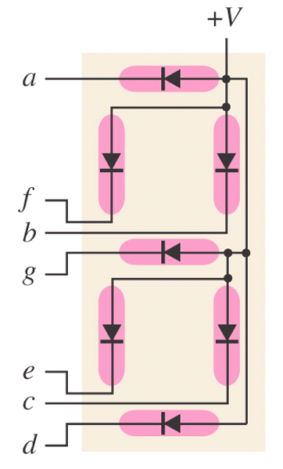
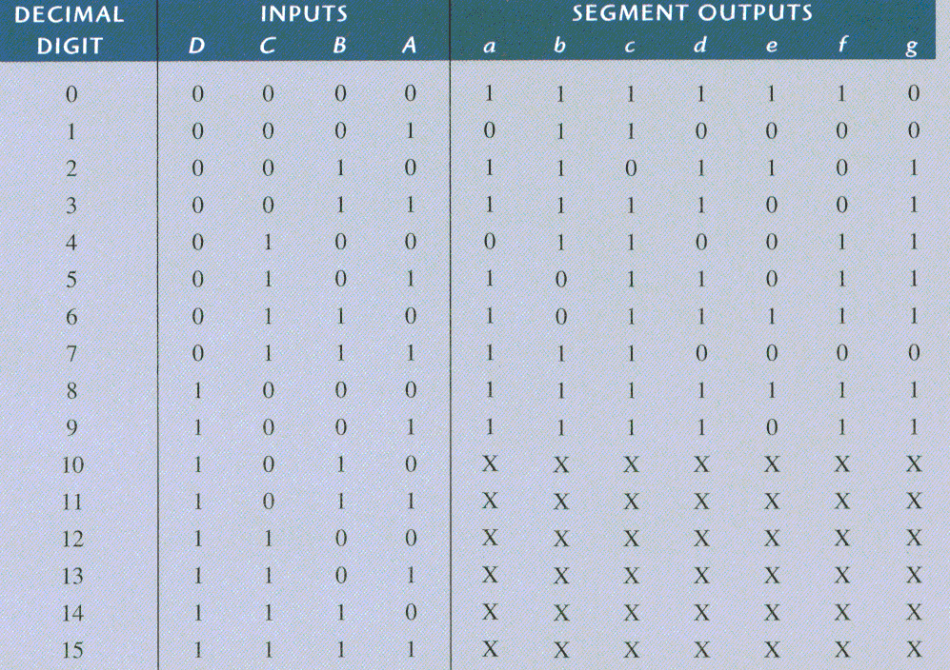
Decoders
BCD-to-7-segement decoder
Common-anode
Logic Diagram
Common Anode has all anodes of LEDs tied to +V

Slide 42
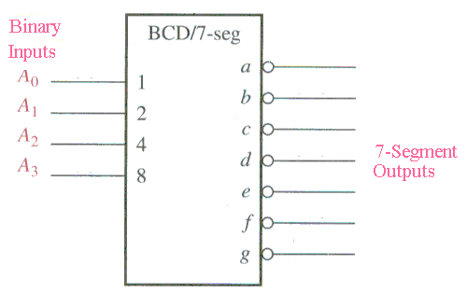
Decoders
BCD-to-7-segment decoder
Truth Table

Slide 43
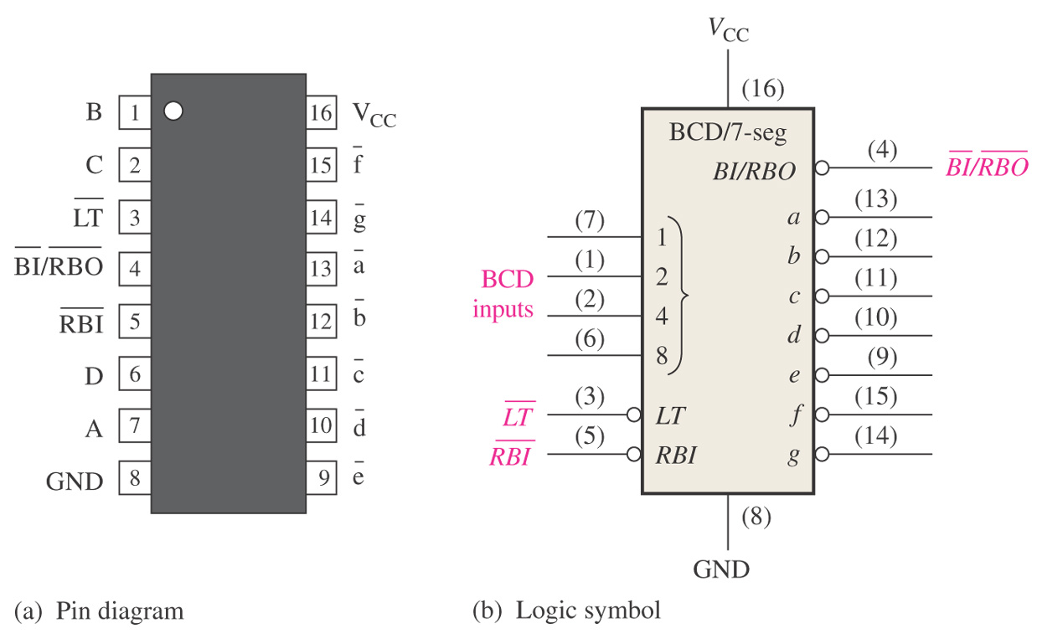
Figure 6–35 Pin diagram and logic symbol for the 74LS47 BCD-to-7-segment decoder/driver.
LT = Lamp Test - when LOW and BI/RBO is HI then all LEDs are ON BI = Blanking Input RBI = Ripple Blanking Input RBO = Ripple Blanking Output
Copyright ©2006 by Pearson Education, Inc. Upper Saddle River, New Jersey 07458 All rights reserved.

Slide 44
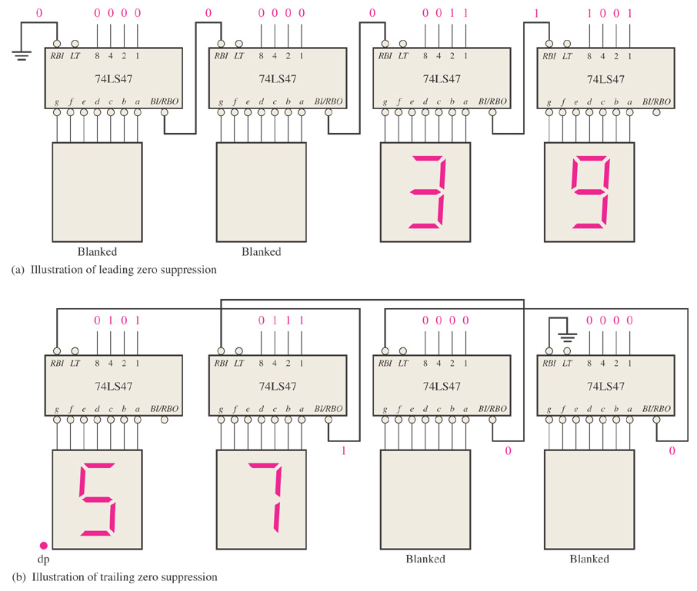
Figure 6–36 Examples of zero suppression using the 74LS47 BCD to 7-segment decoder/driver.
Tie RBI of Right to next left BI/RBO for leading zero suppression. Left most RBI is tied to ground.
Tie RBI of Left to next right BI/RBO for trailing zero suppression. Right most RBI is tied to ground.

Slide 45
Encoders
Decimal-to-BCD encoder
8-line-to-3-line encoder

Slide 46
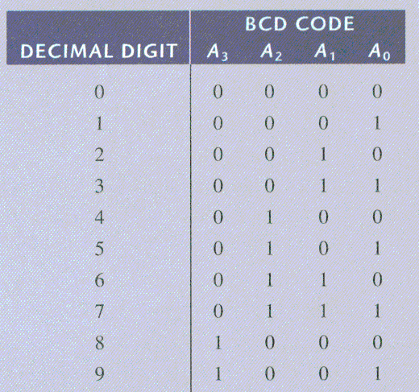
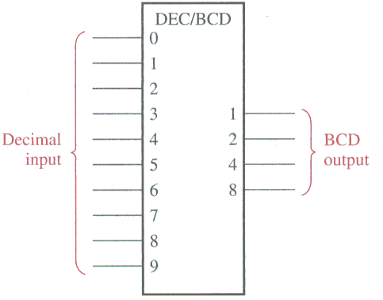
Encoders
Decimal-to-BCD encoder ( 10 inputs, 4 outputs)

Slide 47
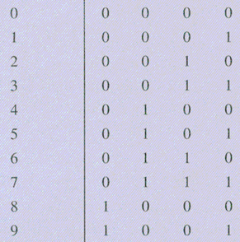
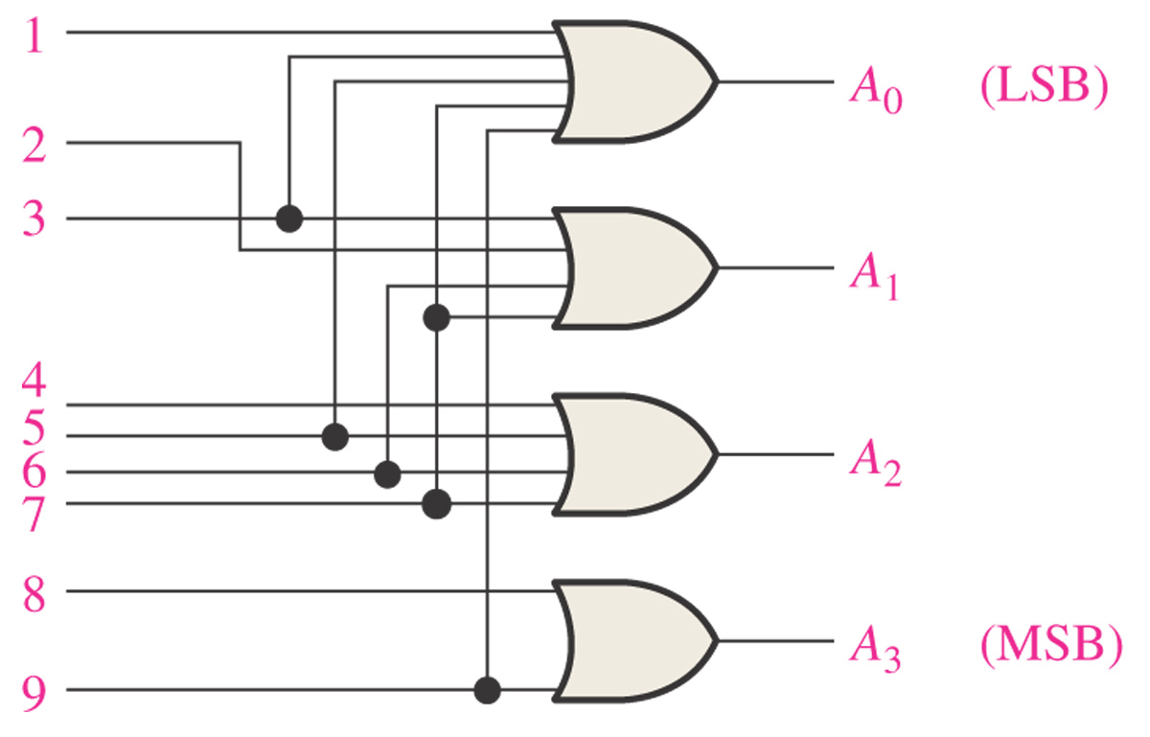
Logic Diagram of Decimal-to-BCD Encoder
All odds
A₀ = 1 + 3 + 5 + 7 + 9
A₁ = 2 + 3 + 6 + 7
A₂ = 4 + 5 + 6 + 7
A₃ = 8 + 9

Slide 48
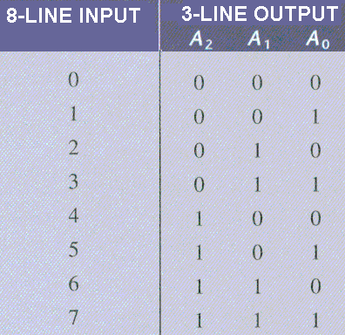
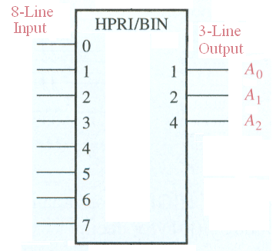
Encoders
8-line-to-3-line encoder
If line 5 on input is high, then output will be 101. Assume only one input is high.

Slide 49
Code Converters
BCD-to-binary conversion
Binary-Gray conversions

Slide 50
BCD
Convert BCD number 00100111 to binary.
Could convert to decimal 27 and then convert to binary.
Can add weights.
80 40 20 10 8 4 2 1 0 0 1 0 0 1 1 1 1 1 10 2 100 4
10100 20
0011011 27

Slide 51
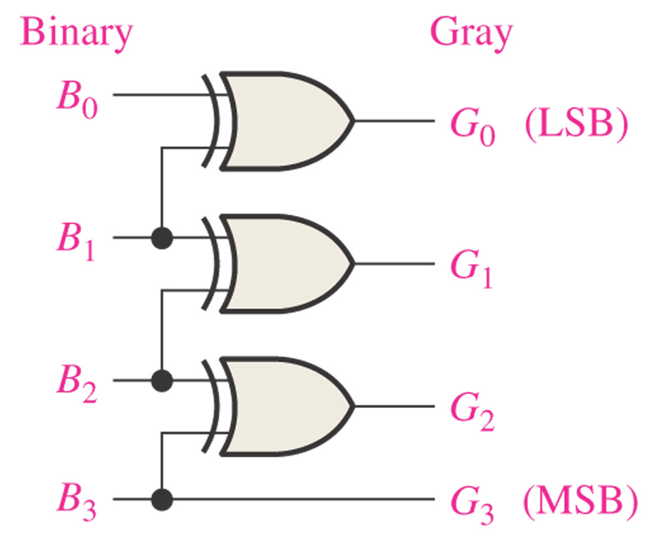
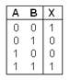
Figure 6–43 Four-bit binary-to-Gray conversion logic.
Convert 1 1 0 0 to Gray
1
0
1
0
XOR

Slide 52

Figure 6–44 Four-bit Gray-to-binary conversion logic.
Convert 1 0 1 0 to Gray
1
1
0
0
XOR

Slide 53
Multiplexers (Data Selectors)
4-input multiplexer
Expanded multiplexers

Slide 54



Multiplexers (Data Selectors)
4-input multiplexer
If Data-Select Inputs are 10, then Y = D₂ If D₂ = 0, then Y = 0. If D₂ = 1, then Y = 1.

Slide 55

What is the output Y if we have the following inputs?
0 1
1 1
1 0 1 0
1 0 1 0
1
0

Slide 56
Demultiplexers
Reverses the multiplexing function.
Sends the data input to the selected output.
Decoders can be demultiplexers.

Slide 57



Demultiplexers
2-line-to-4-line demux

Slide 58

Find the data-output waveforms for the demultiplexer.
S₀ and S₁ select which output line will receive the input data.
If data input is zero, then all outputs will be zero.

Slide 59

Parity Generators/Checkers
Parity generator/checker
Sum of even number of 1s is always 0. Sum of odd number of 1s is always 1.

Slide 60

Figure 6–76. Problem 4. Find the sum based on the inputs. Note: We are adding A = 111 to B = 101.
1
1
0
0

Slide 61

Figure 6–80 Problem 14. Plot the 3 outputs (A>B, A=B, A<B)
A₃A₂A₁A₀ B₃B₂B₁B₀ A>B A = B A<B 1 0 0 1 0 1 0 0 1 0 0 1 1 1 1 1 1 1 1 0 1 0 1 1 1 0 0 0 1 0 1 0 0 1 1 0 0 0 0 1 1 1 0 0 0 1 0 1 1 1 0 0 0 0 1
A>B
A=B
A<B

Slide 62


Figure 6–84. Problem 22. Find sequence of digits that appear.
3
2
1
A₃A₂A₁A₀ 0 0 0 0 0 1 0 0 1 9 1 1 1 1 undefined 0 1 1 1 7
0

Slide 63

Figure 6–85. Like Problem 28.
If S₀S₁ = 11 and D₃D₂D₁D₀ = 1001, what is the output?
= 1

